Slide 1
The Future’s Shiny:
Dashboards for Pioneering Genomic Medicine in R

Slide 2
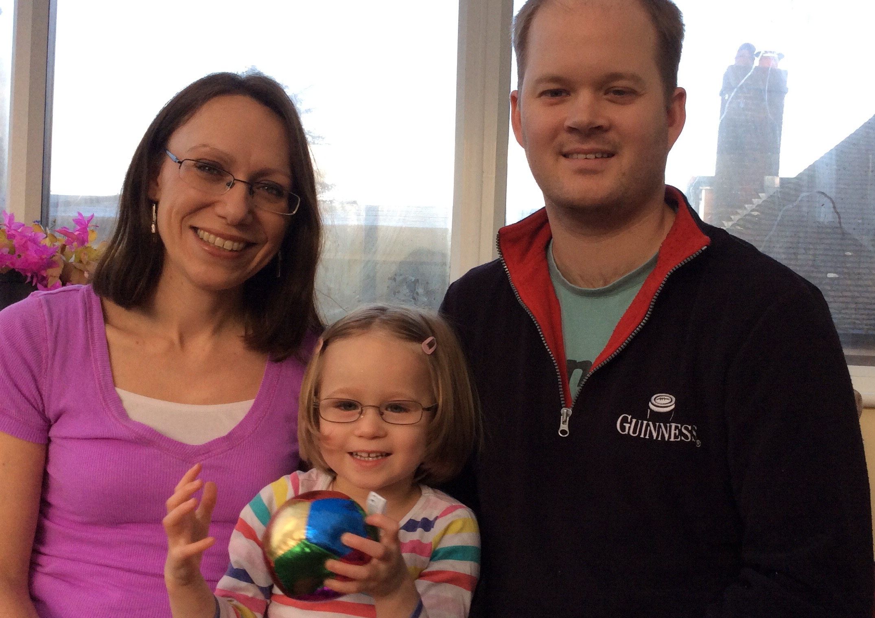
Hundred Thousand Genome Project: Jessica Wright

Slide 3
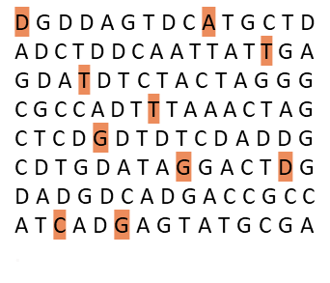
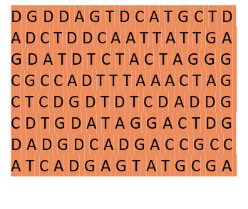
First Full Genome Sequenced in 2003
Previously
Now
Faster and cheaper
Over 10 years … 1 day
Over $2,000,000,000 … less than $1,000

Slide 4


National Genomics Medicine Service
National genomic lab service via network of hubs
Being rolled out to the NHS in 2019
National Genomics Test Directory
NHS first in the world to offer this

Slide 5
Case Pipeline
Clinic
UK Biobank
Illumina
GEL Bioinformatics
Clinical Interpretation Partners
Clinical Report Sent
DNA Extracted
Further analysis
DNA Stored in national biorepository
Results analysed
DNA Sequenced

Slide 6
R Packages
Core Packages
Look & Feel
htmlwidgets
shiny
tidyverse
DBI
httr
shinyjs
shinydashboard
shinycssloaders
shinyBS
shinyalert
shinyWidgets
kableExtra
plotly
DT
sunburstR
visNetwork
timevis
listviewer

Slide 7
App Design Priorities
To create an app that could be used by people across the project
For each dashboard to answer a small subset of questions well
Fast iterations and featured additions

Slide 8
Program Manager at Genomics England
How close are we to the 100,000 genomes target?
How many of these come from patients with cancer or rare diseases?
How do our metrics break down by stage of the process?
Where are samples getting stuck in the pipeline and how does this vary by clinic?

Slide 9
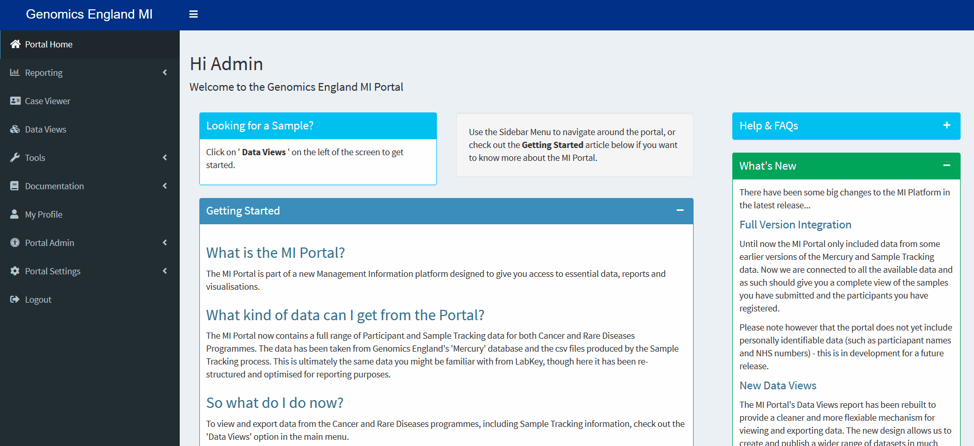
MIS Portal

Slide 10
Sample Team in Lab
Flag up problem with the sample
What are the other related samples in the case hierarchy?
Has this sample been flagged before?

Slide 11

MIS Portal

Slide 12
Scaled Up Application

Slide 13
How did we scale the app?
Horizontally and vertically
Realistic user paths
Use profvis and shinyloadtest

Slide 14
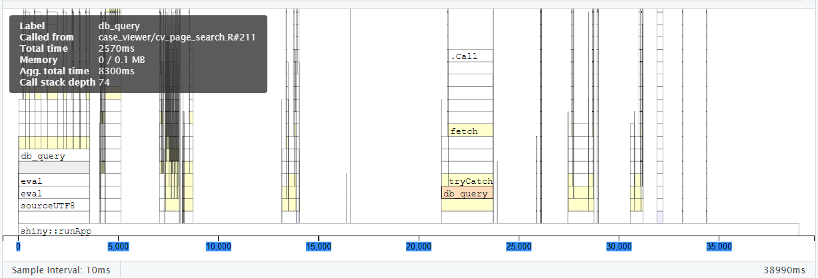
profvis: Finding our Watermelons
Database calls
API call

Slide 15
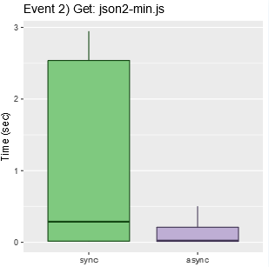
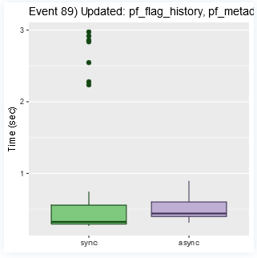
shinyloadtest: optimising consistency

Slide 16

Optimise Your Shiny Code First
Don’t get hung up on making everything asynchronous
Reactive code is easier to update than imperative code

Slide 17
Optimise DB functions
Writing efficient SQL is important
Take advantage of advanced functionality
DB functions simplify things

Slide 18
Optimise Data Loading
htmlwidgets are great for interacting with data
Use careful timing to decide when/what loaded from the DB functions

Slide 19
Conclusions
Design decision affect the kind of scaling needed
Thinking carefully about database functions is important
Optimise for 1 user before optimizing for multiple users
Shiny is scalable

Slide 20




Thank You!
Nic Crane
nic.crane@elucidata.co.uk
Twitter: @nic_crane
elucidata.co.uk

